Slide 1
Create Website’s Home Page
Task List:
Create home page (index.jsp)
Create home page servlet (HomeServlet.java)
Create header (header.jsp)
Create footer (footer.jsp)

Slide 2
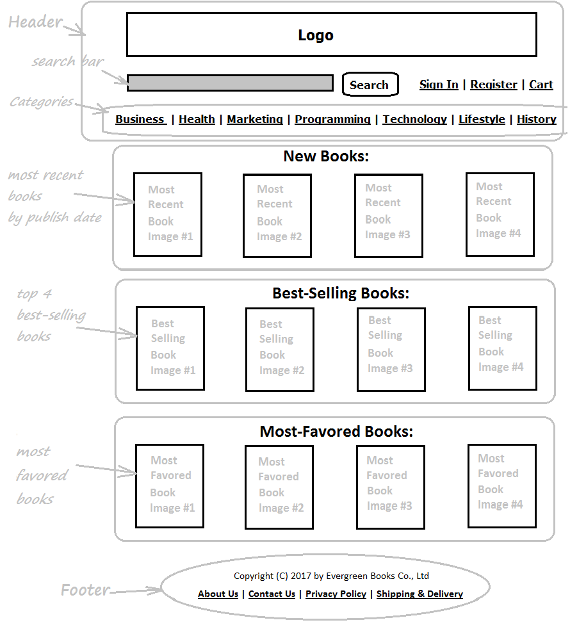

Slide 3
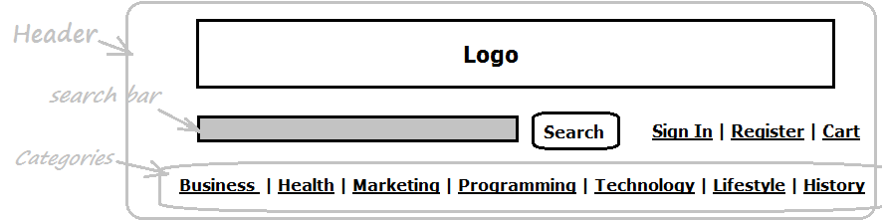
Header

Slide 4

Footer

